Slide 1
Barriers to communication

Slide 2
Give proper attire to ideas
Right response means success
Suffer due to poor communication skills.
Factors responsible for the breakdown of communication process are known as barriers to communication

Slide 3
5 Steps to identify barriers
Identify the problem
Find the barrier
Work for alternative solution
Opt for the best solution
Follow up rigorously

Slide 4


Slide 5
INTRAPERSONAL
INTERPERSONAL
ORGANIZATIONAL
CLASSIFICATION OF BARRIERS

Slide 6


Slide 7
WRONG ASSUMPTIONS
VARIED PERCEPTIONS
DIFFERING BACKGROUND
WRONG INFERENCES
IMPERVIOUS CATEGORIES
CATEGORICAL THINKING
INTRAPERSONAL BARRIERS

Slide 8
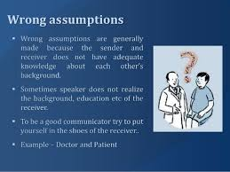

Slide 9
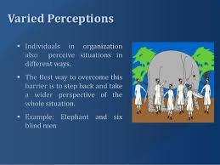

Slide 10
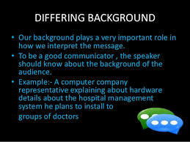

Slide 11
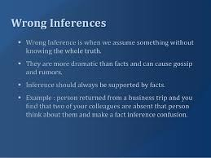

Slide 12
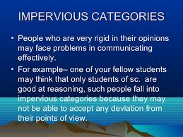

Slide 13
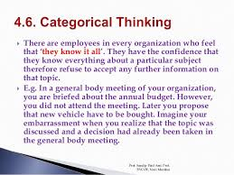

Slide 14
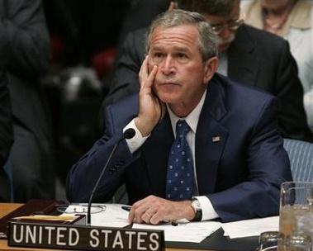

Slide 15
LIMITED VOCABULARY
MISINTERPRETED VERBAL OR NON-VERBAL MESSAGES
EMOTIONAL OUTBURSTS
COMMUNICATION SELECTIVITY
CULTURAL VARIATIONS
POOR LISTENING SKILLS
NOISE IN THE CHANNEL
INTERPERSONAL BARRIERS

Slide 16
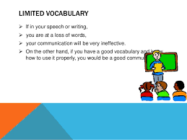

Slide 17
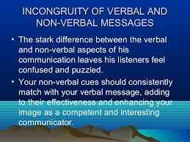

Slide 18
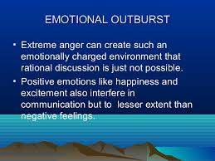

Slide 19
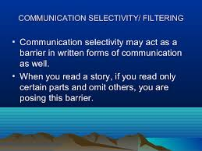

Slide 20
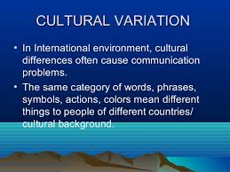

Slide 21
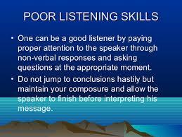

Slide 22
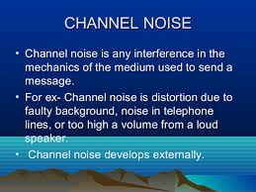

Slide 23
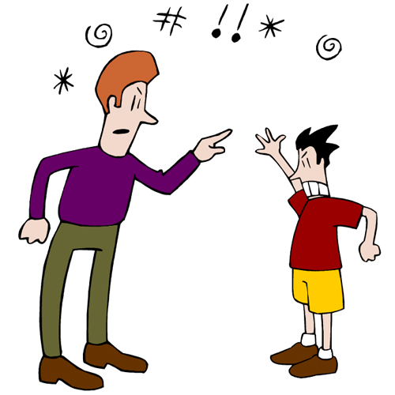

Slide 24
TOO MANY TRANSFER STATIONS
FEAR OF SUPERIORS
NEGATIVE TENDENCIES
USE OF INAPPROPRIATE MEDIA
INFORMATION OVERLOAD
ORGANIZATIONAL BARRIERS

Slide 25
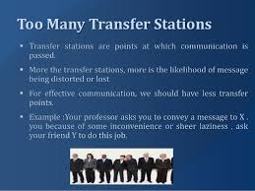

Slide 26
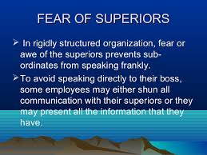

Slide 27
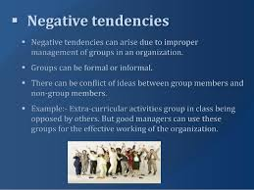

Slide 28
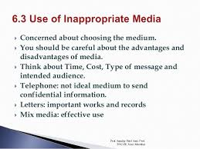

Slide 29
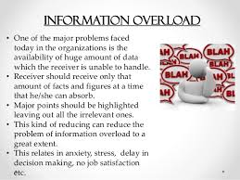

Slide 30
Objective Type Question
Q. 1 What is intra-personal barrier to communication?
a. Barriers between person to person b. Individuals inbuilt barriers
c. External barriers d. Emotional barriers
Q. 2 Any change in the meaning of the message sent and the message received is called-------------------------..
a. barrier b. interruption c. break
Q. 3 The inbuilt barriers in a person are called-------------------------barriers .
a. intra – personal b. mass c. internal
Q. 4 ---------------------------------- barriers occur due to the inappropriate transaction of words between two or more individuals.
a. intra – personal b. inter- personal c. internal
Q. 5-------------------- barriers badly affect the functioning of any organization.
a. intra – personal b. inter- personal c. organizational

Slide 31
Question that are asked in University Exams
Q. 1 Discuss organizational Barriers to technical communication in a professional organization. (2008)
Q. 2 Discuss intra personal barrier in communication.

